Slide 1
Introduction to python

Slide 2
WHAT IS PYTHON?
Python is a high-level, interpreted scripting language that can be used for developing simple or complex applications quickly.
It uses English keywords, less punctuation and fewer syntactical constructs than other programming languages making it an easy language to learn for those with little or no programming experience.
Python is Interpreted which means that the code is processed at runtime by the interpreter and does not need to be compiled before execution. This is similar to PERL and PHP.
It supports procedural as well as object-oriented programming techniques.

Slide 3
PYTHON FEATURES
Easy to learn − Python has few keywords, simple structure, and a clearly defined syntax. This allows the student to pick up the language quickly.
Easy to read and maintain − Python code is easier to read and therefore it is easier to understand and maintain someone else’s code
Portable − Python can run on a wide variety of hardware platforms and has the same interface across all platforms
Database support − Python provides interfaces to all major commercial databases.
Modular - supports the use of modules and packages, which means that programs can be designed in a modular style and code can be reused across a variety of projects

Slide 4
WRITING PYTHON CODE
You can write a Python program in a normal text editor such as Notepad, save it as a .py file and execute it within the Python interpreter.
However, like most programming languages, it is simpler to develop code in an integrated development environment (IDE) which provides a GUI with a language-sensitive editor that helps you to write you write and debug your code, provides helpful prompts for language syntax, highlights coding errors and work on development projects.
There are a wide-range of IDEs available for Python including:
Visual Studio Code (which we will use on this unit)
PyCharm
Spyder
Jupyter
Eclipse

Slide 5
Basic python CONCEPTS
This week, we will look at the following basic Python concepts:
Printing and formatting output to the screen
Variables
Getting input from the user
Running code based on certain conditions (if statements)
Repeating code a certain number of times or while a condition is true (while and for statements)
Working with lists
Indentation and comments
Importing modules

Slide 6
Basic python CONCEPTS
All Python keywords must be written in lowercase e.g. if, else, for while etc. The only exceptions to this are True, False and None which need to be written with an initial capital letter.
Therefore If or IF, false or FALSE would generate a syntax error.

Slide 7
variables
In Python, just like all other programming languages, we need to temporarily store data in memory for use within the program. These temporary storage areas are called variables and each variable has a name and a value.
To assign a value to a variable, you use the following syntax:
variable_name = value
Examples:
age = 12 # assign an integer value
name = “Darren” # assign a string value
under_18 = True # assign a boolean value

Slide 8
variables
To use a variable, you refer to it by its name, for example:
age = age + 1
Python variables are dynamically-typed so do not need to be defined as a particular type at the beginning of the program unlike some other programming languages.
Variables are case-sensitive i.e. num is a different variable to Num.

Slide 9
PRINTING OUTPUT TO THE SCREEN
To print output to the screen, we use the print command
Syntax variants:
1. print("some text")
2. print("some text", variable, "some more text")
Examples:
print("Main menu")
print("Your age is ",age)

Slide 10
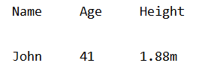
FORMATTING string values
The following escape characters can be used in the print
command:
\t Tab
\n New line
For example:
name = "John"
age = 41
height = "1.88m"
print("Name \t Age \t Height \n")
print(name,"\t",age,"\t",height)
Blank line due to the use of \n

Slide 11
FORMATTING string values
The example below shows the use of the .format method which replaces {0} and {1} with the values of variables name and age accordingly. It also shows the \ escape character which is required if some text you want to print contains a ‘ or “
name = "John"
age = 41
print("My name is {0} and I\'m {1} years old".format(name,age))

Slide 12
FORMATTING string values
Below are a few useful string methods available that can be used in the print statement:
.upper() Converts string to all uppercase
.lower() Converts string to all lowercase
.join() Concatenates multiple strings into one
.center() Centres a string
.ljust() Left-justifies a string
.rjust() Right-justifies a string
Multiple string methods can be used in the same print statement.

Slide 13
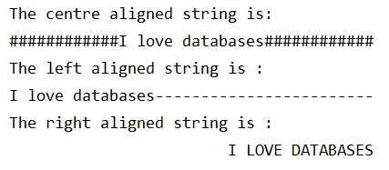
FORMATTING string values
The following example shows different justification for text
mystr = "I love databases"
print("The centre aligned string is : ")
print(mystr.center(40, '#'))
print("The left aligned string is : ")
print(mystr.ljust(40, '-'))
print("The right aligned string is : ")
print(mystr.upper().rjust(40))

Slide 14
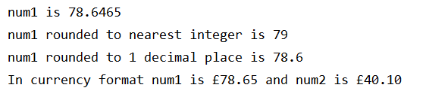
FORMATTING floating point values
There are many ways to format floating point values e.g.
num1 = 78.6465
num2 = 40.1
print("num1 is {0}".format(num1))
print("num1 rounded to nearest integer is {0:.0f}".format(num1))
print("num1 rounded to 1 decimal place is {0:.1f}".format(num1))
print("In currency format num1 is £{0:.2f} and num2 is £{1:.2f}" \
.format(num1,num2))
Inside the {}, 0 and 1 are the fields to be printed. These are replaced by the corresponding values in the .format method. The : indicates a conversion to the following data type - .0f is a floating point number with 0 decimal places, .1f is 1 decimal place and .2f is 2 decimal places.

Slide 15

printing values in columns
If you want to print values in fixed-width columns, you use format width values as shown below:
num1 = 78
num2 = 4010.1
num3 = 101
num4 = 188.7
str1 = “Black”
str2 = “Turquiose”
print(“{0:10}\t{1:5d}\t{2:7.2f}".format(str1,num1,num2))
print(“{0:10}\t{1:5d}\t{2:7.2f}".format(str2,num3,num4))
Inside the {}, 0, 1 and 2 are the fields to be printed. These are replaced by the corresponding values in the .format method. The number after the : indicates the width of the column (10, 5 and 7), d indicates an integer value and .2f is a floating point value with 2 decimal places.

Slide 16
Getting input from the user
In order to make your program interactive, you can get input from the user by using the input command
Syntax variants:
# Input a string, no prompt is displayed
variable_name = input()
# Input a string with a prompt
variable_name = input(“Prompt “)
# Input a integer number with a prompt
variable_name = int(input(“Prompt “))
# Input a floating point number with a prompt
variable_name = float(input(“Prompt “))

Slide 17
Getting input from the user
Examples:
name = int(input("Enter your name: ")
age = int(input("Enter your age: "))
height = float("Enter your height in metres: "))
Int and float are functions that convert the value the user has entered into an integer or floating point value respectively.

Slide 18
If statement
In your code, you will often need to make decisions and run certain code if a condition(s) are true. To do this, you use the if statement.
Syntax variants:
1. if condition:
<some code> # code that runs if condition is true
2. if condition:
<some code> # code that runs if condition is true
else:
<some code> # code that runs if condition is false

Slide 19
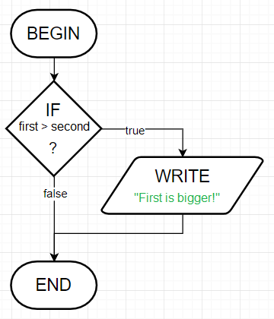
If statement
Example:
if (first_number > second_number):
print("First number is bigger")
Note: The code inside the if has to be indented

Slide 20
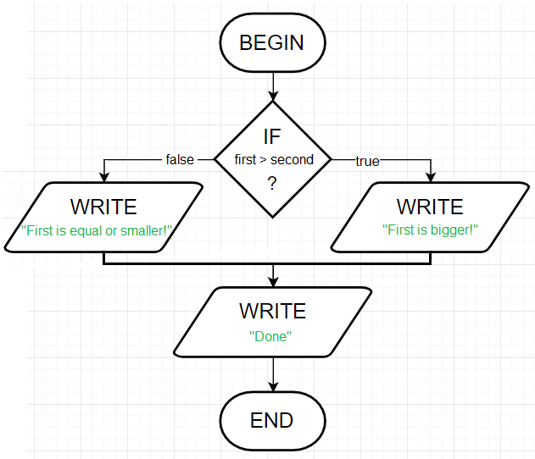
If statement
Example:
if (first_number > second_number):
print("First number is bigger")
else:
print("First number is equal or smaller")
print (“Done”)

Slide 21
Comparison operatorS
Below are the available comparison operators in Python:
== Equal to
> Greater than
< Less than
>= Greater than or equal to
<= Less than or equal to
!= Not equal to
IN In a list of values
NOT IN Not in a list of values

Slide 22
Multiple conditions
In an IF statement, we might need to test more than one condition is true separated by the following logical operators:
AND – both condition1 and condition2 are true
OR – either condition1 or condition 2 is true
NOT – test for false
Examples:
if age <= 18 or age >= 65:
if age <= 18 and gender == male:
if age <= 18 and not (gender = male):

Slide 23
NESTED If statements
Sometimes, it is necessary to have one IF statement inside another (known as nested).
Syntax:
if condition1:
<some code>
if condition2:
<some code>
else:
<some code>
else:
<some code>

Slide 24
LOOPS – FOR STATEMENT
In Python, we may wish to run a section of a certain number of times – called a loop or a definite iteration. We do this using the for statement
Syntax variants:
for variable in range(start, end):
for variable in list:

Slide 25
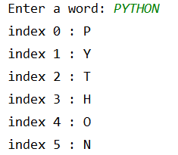
LOOPS – FOR STATEMENT
Example – Get the user to input a word and then print each character on a new line.
word = input("Enter a word: ")
for count in range(0, len(word)):
print("index", count, ":", word[count])

Slide 26
LOOPS – while statement
As an alternative to looping through a section of code a certain number of times, we may wish to run a section of code while a certain condition is true (called an indefinite iteration). We do this using the while statement.
Syntax:
while condition:
<some code>
The condition should become true within the loop otherwise you will get an infinite loop and the code will never end.

Slide 27
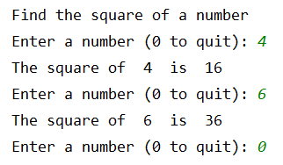
LOOPS – while statement
Example: Get the user to enter a number and calculate the square of that number. Do this repeatedly until the user enters a 0.
print(“Calculate the square of a number")
num =int(input("Enter a number (0 to quit): "))
while num != 0:
square = num * num
print("The square of ",num," is ",square)
num =int(input("Enter a number (0 to quit): "))

Slide 28
Working with lists
A list is an ordered list of values which can be of any type (integer, string or floating point)
A list has to be initiated either as an empty list or with an initial set of values e.g.
colour_list = [] # initiates an empty list
colour_list = [‘white’,’red’] # initiates a populated list
num_list = [8,6,5,9,1] # initates a populated list
You can then do many things with a list including adding, modifying and removing values.
To add a value to a list, we use listname.append(value) e.g.
colour_list.append(‘black’)

Slide 29
Working with lists
To remove a value from a list, we use listname.remove(value) e.g.
colour_list.remove(‘red’)
To access the nth value on a list, we use listname[n-1] as the first element of a list is 0 e.g. nth_item = num_list[n-1])
You can count the number of items in a list using len(listname)
count = len(num_list)
To check if an item is in a list, use in listname
if num in num_list:
To check if an item is not in a list, use not in listname
while num not in num_list:

Slide 30


WORKING WITH LISTS
Example – Print each item in a list on a separate line
name_list = ['Darren', 'Kenton', 'Anton']
for name in name_list:
print("Next name in the list is",name)
Example - Print the second item in the list
name_list = ['Darren', 'Kenton', 'Anton']
print("Second name in the list is",name_list[1])

Slide 31
comments
It is good practice to put comments in your code to aid readability and make it easier to maintain. Comments are indicated by the use of the # character
Example:
# test if the first number is bigger than the second
if (first_number > second_number):
print("First number is bigger")
else:
print("First number is equal or smaller")
print (“Done”)

Slide 32
Importing other modules
Sometimes it is necessary to import other Python modules into your code to gain access to other code or functions not available by default.
Syntax:
import module_name
The import command is placed at the top of your code.
Example: To generate a random integer between 1 and 10
import random
num=random.randint(1,10)
print(“The random number generated is”,num)

Slide 33
A full python code example
# denotes a comment
num is an integer variable set to
a value input at runtime
prime is a boolean variable
set initially to True
if statement
for loop
% is the remainder from the division
of num by i
print displays text to the screen
break is the keyword to exit the
loop immediately
# Program to check if a number is prime or not
# Get user to enter a number
num = int(input("Enter a number: "))
prime = True
# prime numbers are greater than 1
if num > 1:
# check for factors
for i in range(2, num):
if (num % i) == 0:
print(num, "is not a prime number")
print(i, "times", num // i, "is", num)
prime = False
break
if prime:
print(num, "is a prime number")
# if input number <= 1, it is not prime
else:
print(num, "is not a prime number")

Slide 34
important things to note
Indentation affects how the code is interpreted so be careful to indent correctly:
for i in range(2, num):
if (num % i) == 0:
print(num, "is not a prime number")
print(i, "times", num // i, "is", num)
prime = False
break
if prime:
print(num, "is a prime number")
The code in red executes after the for loop
has been exited
for i in range(2, num):
if (num % i) == 0:
print(num, "is not a prime number")
print(i, "times", num // i, "is", num)
prime = False
break
if prime:
print(num, "is a prime number")
The code in red executes for each iteration
of the for loop

